Slide 1
Keyless Lock

Slide 2
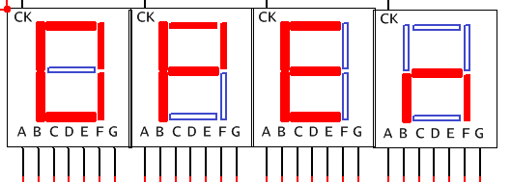
Keyless Lock
You will design a “lock” mechanism that opens when the correct code is entered.
First place 5 seven-segment displays in a row and hardwire the negative pins so that the displays will read “OPEn” as seen bellow. Use active high displays. Leave the positive pins unconnected for now.

Slide 3
Keyless Lock
Pick a number from 0 to 9. This will be your “secret code” that will open the lock.
You will need to use SR_FFs to hold the binary bits the user enters in the lock. This is so that the code will only “sent” when the user has finished entering the code and has pressed the “enter button.”

Slide 4
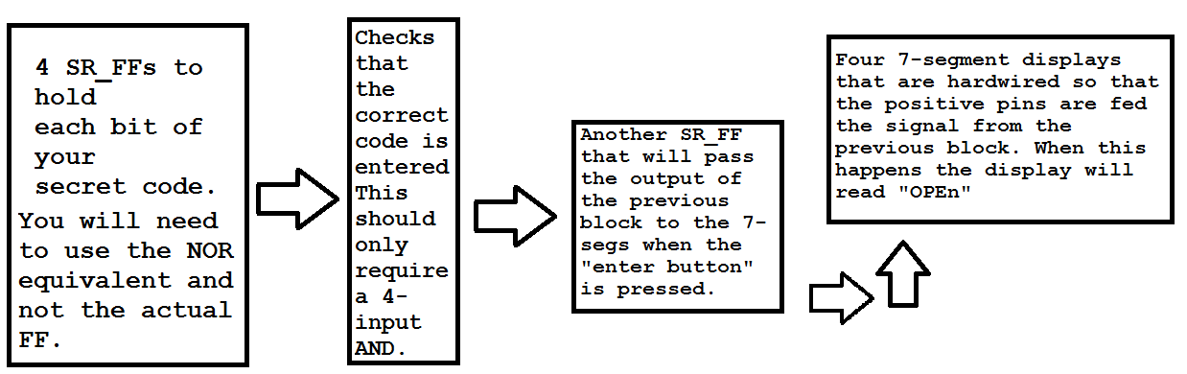
Keyless Lock Organizational Diagram

